Slide 1

Which App Store Gets Better Reviews?
A comparison of reviews from both the Google Play store and the Apple Apps Store – Sharon Juge

Slide 2
Gathering + Condensing Data
We gathered data collected regarding Google Play Store and Apple Apps Store via Kaggle, and uploaded them into two data tables
We condensed and combined those tables to represent the Category, Rating Level, Number of Reviews, and Price of the different apps hosted either platform

Slide 3
Modelling Data
After creating one table representing our data – we turned the data into visual graphs, found the averages and standard deviations of the ratings of each platform, and deduced the accuracy of our data
Inaccuracy of data is almost 0% and will follow trends
platform | count | mean | std | min | 25% | 50% | 75% | max
apple | 6268.0 | 4.049697 | 0.726943 | 1.0 | 4.0 | 4.5 | 4.5 | 5.0
google | 9366.0 | 4.191757 | 0.515219 | 1.0 | 4.0 | 4.3 | 4.5 | 5.0

Slide 4
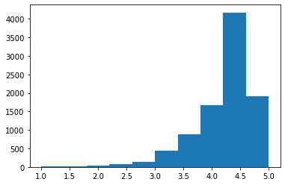
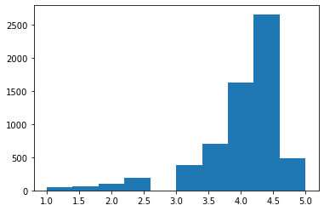
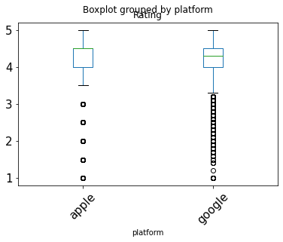
Visuals
The two bar graphs are of number of ratings vs rating level
- Google Play Store (first) + Apple Apps Store (second)
The box plot is of spread of ratings between the two platforms

Slide 5
Conclusions
On average the Google Play Store has ratings of 4.19 while the Apple Apps Store has ratings of 4.05
This means platform does influence ratings and Google Play Store is the preferred platform for applications.

